Slide 1
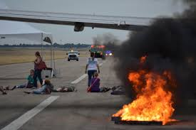
Lab Emergencies
OH MY GOD! WHAT DO I DO?????????

Slide 2
Types of emergencies
Intruder / Active Shooter
Medical
Belligerent / Abusive Student
Weather Closure

Slide 3
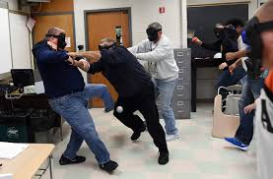
Intruder / Active Shooter
Campus Safety Training
In all cases it is about your safety and your fellow students.
Remember “RUN, HIDE, FIGHT”
Run: Get away from the threat if the risk is worth it
Hide: Create q safe space by locking and/or blocking doors
Fight: Confront assailant only if absolutely necessary
Tiger Safe app (INSTALL ON YOUR PHONE)

Slide 4

Medical
Bleeding
Small cuts / injuries – send to health center – clean area.
Large issues
Contact Campus Safety via Tiger Safe
Injured person sitting, may need to have lie down.
Pressure on wound (paper towels work).
Ask students to leave the lab until incident is over.
Contact lab managers after incident is over with information.
Seizures
Leave student alone with following caveats
Put backpack, vest, jacket under head
Clear any objects they may hit away from them.
Contact Campus Safety via Tiger Safe
Ask other students to leave the lab until incident is over.
Contact lab managers after incident with information

Slide 5

Medical
Sick / Messy (i.e. vomiting)
Have student leave and go to health center.
If unable to:
Tiger Safe
Close Lab
Contact FMS for emergency sickness clean up (585) 475-2842
Report incident to supervisor
Other issues?
When in doubt contact Tiger Safe or supervisor (John’s cell phone number is posted in the cage)

Slide 6
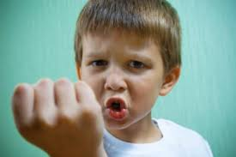

Belligerent\ abusive
What is considered belligerent / abusive
Yelling at person after being asked to lower voice
Physical threats (“I’ll take you outside and show you!”)
Will not leave labs when asked
Makes other students uncomfortable (i.e. won’t leave them alone after being asked).
Touching after being asked to stop.
This is not “You’re a poopy head!”
This IS continued aggression / fear of harm if continues
Holds for faculty/staff/students
Steps
Ask the person nicely to stop the activity
If continues:
Day find lab manager / system administrator/ office manager with situation
Night – Tiger Safe and report incident to supervisor.

Slide 7
Weather closures
RIT will send emails, texts, post if they are closing early due to weather.
https://emergency.rit.edu/weather-related_closing.php
If RIT closes, labs close. Ask students to save work, close labs and lock.
In rare circumstances, labs may close BEFORE RIT does to keep students safe. You will be notified by your supervisor of the closure and signs will be put on the monitors for students.
If you have a shift while RIT is officially closed due to weather, DO NOT REPORT. You will be paid for the shift according to current RIT payroll rules. (i.e., you probably can’t be paid)
SAFETY first.

